Slide 1
Health Monitoring Using Mobile Phones
Course:- Mobile Networking
Instructor:- Dr. Helmy Ahmed
Group 2
Presented By:-
1. Rishabh Krishna
2. Sk Minhazul Islam
3. Bharath Yarlagadda

Slide 2
Contents
Introduction
Why Health Monitoring?
Brief Discussion on Related Work
Comparison of Existing Works
Pros and Cons of Health Monitoring System
Addressing issues in Mobile Health Monitoring
Conclusion

Slide 3
Introduction
The consumers and healthcare service providers using smart phones are growing exponentially throughout last decade.
The adoption of this technology is rapid; two-thirds of physicians and 42% of the public used smartphones as of late 2009. [1]
As of February 2010, there were nearly 6,000 such apps within the Apple App Store.
Of these, 73% were intended for use by consumer or patient end-users, while 27% were targeted to healthcare professionals.

Slide 4
Why Health Monitoring?
Based on World Health Organization’s Statistics (WHO) and other sources, chronicle diseases and psychological pressures are behind the death of 80% of elderly people (e.g. in Algeria).
The greater part of elderly suffer from various chronic diseases.
We plan to elucidate on how recent advancement in wireless communication and smartphone technology have empowered tremendous improvement in health monitoring services.
Provide behavioral feedback about someone’s health in order to prevent diseases.

Slide 5
Initial Work
Vital signs are the most basic functions that can be measured from a person.
Provide health monitoring at home, which is particularly useful for patients, who have to live alone.
Focused on the automatic and unobtrusive measurement of biomedical signals and activities of patients.
Ubiquitous health monitoring is an important precursor for analysis and diagnosis, as it allows biomedical signals to be measured without the individual’s awareness.

Slide 6
Areas of Exploration…
ECG Signal measurement on bed –
Signal obtained by using a conductive sheet on bed.
ECG signals are measured by a conductive textile electrode attached to the bed sheet.
Load cells to measure body weights –
Weight losses are very alarming.
May indicate hormonal imbalance.
Reason can be tumors, as they break muscles and kill appetite.
In load cells, voltage readings can be converted to weights.

Slide 7
Areas of Exploration Contd…..
Respiratory Problems: Snoring –
Health risks of sleep apnea; a respiratory condition in which the throat narrows or closes during sleep.
Condition can increase the risks of high blood pressure, coronary heart disease, stroke and diabetes.
Uses electret microphones; a fusion of electrode and magnet.
Monitoring day-to-day activities –
Routine exercise on a day to day basis.
Blood sugar levels.
Use of accelerometer and gyro meter.

Slide 8
Areas of Exploration Contd…..
Measuring Temperatures of Body –
Difficult as a mobile device has its own temperature.
Generally uses infra-red equipped with peripheral devices.
Infrared: Go / No Go?
Blood-Oxygen saturation –
Checks the level of oxygen in blood.
Uses the phone’s built-in video camera.
The patient’s fingertip is pressed against the lens of the camera.
Captures small changes in light reflected by the pulsing blood in the capillaries.

Slide 9
A Wireless Body Area Network of Intelligent Motion Sensors for Computer Assisted Physical Rehabilitation [2]
Emil Jovanov, Aleksandar Milenkovic, Chris Otto and Piet C de Groen

Slide 10
Characteristics
Wearable health monitoring systems integrated into a telemedicine system
Continuous monitoring as a part of a diagnostic procedure
Support Early Detection of Abnormal Conditions and Prevention of Its Serious Consequences
Provides Supervised Recovery From an Acute Event or Surgical Procedure

Slide 11
There are Some Limitations in Existing Topologies
Traditional personal medical monitoring systems
Data were collected via off-line processing
Wires may limit the patient’s activity and level of comfort
negatively influence the measured results
Nonexistent support for massive data collection and knowledge discovery

Slide 12
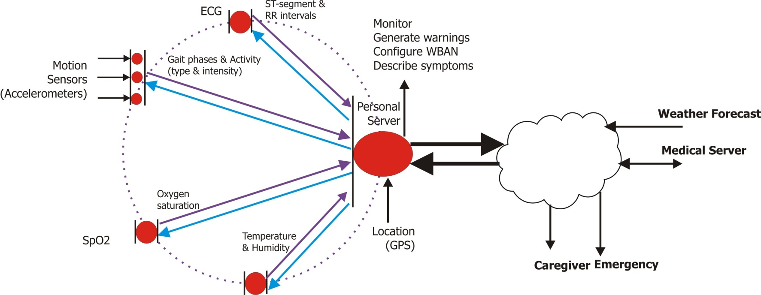
Data flow in an WBAN
Sensor level
Personal Server Level
Medical Service Level

Slide 13
Sensor Level
ECG(electrocardiogram) sensor for monitoring heart activity
EMB(electromyography) sensor for monitoring muscle activity
A blood pressure sensor
A tilt sensor for monitoring trunk position movement

Slide 14
Sensor Level Contd…..
A “smart sock” sensor or a sensor equipped shoe insole to delineate phases of individual steps
Continuously collect and process raw information, store them locally, and send them to the personal server
Minimal Weight of the Sensors
Low-power operation to permit prolonged continuous monitoring Patient-specific calibration, tuning and customization

Slide 15
Personal Server Level
Initialization, configuration and synchronization of WBAN nodes
Control and monitor operation of WBAN nodes
An audio and graphical user-interface for early warnings or guidance

Slide 16
Personal Server Level Contd…..
Secure communication with remote healthcare provider servers like
Internet-enabled PDA
3G cell phone
A home personal computer

Slide 17
Medical Service Level
An emergency service
If the received data are out of range (from normal) or indicate an imminent medical condition
The exact location of the patient
If the personal server is equipped with GPS sensor
Monitoring the activity of the patient
By medical professionals
Issue altered guidance based on the new information

Slide 18
Summary
Continuous monitoring in the ambulatory setting
early detection of abnormal conditions
increased level of confidence
improve quality of life
supervised rehabilitation
potential knowledge discovery
through data mining of all gathered information

Slide 19
MobiHealth: Ambulant Patient Monitoring Over Public Wireless Networks[3]
Dimitri Konstantas, Aart Van Halteren, Richard Bults, Katarzyna Wac, Val Jones, Ing Widya and Rainer Herzog

Slide 20
Characteristics
Health BAN (Body Area Network) is paired with advanced wireless communication.
It enables remote management of chronic conditions and detection of health emergencies and also maximizes patient mobility
It is a generic Body Area Network (BAN) for healthcare (more general).

Slide 21
Characteristics Contd…..
Measured Bio signals is converted to the Electrical Signals by sensors connected to the BAN
It gets transmitted to the remote healthcare location (hospitals or rooms of doctors) over public wireless networks (GPRS/UMTS)

Slide 22
Characteristics Contd…..
Practical Deployment
MobiHealth BAN and service platform have been tested in four European countries like Sweden Nederland, Spain and Germany with a variety of patient groups and thus signifying
its practical appeal to the community

Slide 23
Characteristics Contd…..
Apart From Sensors, it supports any body worn device, hence the system has potentially many applications in healthcare which allow healthcare services to delivered in the community

Slide 24
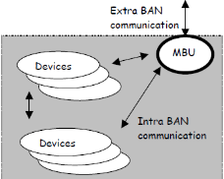
MobiHealth System and Services

Slide 25
MobiHealth System and Services Contd…..
The healthcare BAN is an innovative health monitoring tool that consists of sensors, actuators, communication and processing facilities
Communication between entities within a BAN is called intra-BAN communication.

Slide 26
MobiHealth System and Services Contd…..
To use the BAN for remote monitoring external communication is required which is called extra-BAN communication. The gateway that facilitates extra-BAN communication is called the Mobile Base Unit (MBU)

Slide 27
The MobiHealth Trial
The overall goal of the MobiHealth project is to test the ability of 2.5 and 3G infrastructures to support value added healthcare services.
There were exhaustive testing of Mobihealth trials span four European countries like Sweden, Germany, Nederland and Spain
It covers a range of conditions including pregnancy, trauma, cardiology, rheumatoid, arthritis and respiratory insufficiency

Slide 28
Trial 1
The target group in this trial was patients with ventricular arrhythmia who are undergoing drug therapy.
ECG measurements was taken regularly to monitor the efficienyof drug therapy.
The patient is able to transmit ECG and blood pressure via GPRS from home or elsewhere to the health call center, where the vital signs were monitored via some cardiologists.

Slide 29
Summary
We have avoided the rests of trials for time constraints.
In this way, it is shown that WBAN (Wireless Body Area Network) has played a significant part in Mobile Health which has reduced human effort in a great way by remotely monitoring human health.

Slide 30
ECAALYX
ECAALYX – Enhanced Complete Ambient Assisted Living Experiment.
ECAALYX is a an android application funded by the European Union.
ECAALYX was developed to monitor 24/7 the health and well being of the healthy old people.
This application gathers data periodically, analysis them and conveys to the caretaker as per need.
The application gathers clinical and non clinical data like Heart Rate, Temperature, body weight, glucose levels, GPS location of the person.

Slide 31
Contd…
Some of the sensors are built into the device, some fixed sensors at the persons house and others are wearable.
The sensors mainly used are accelerometers (for fall detection), GPS, glucose meters, ECG monitors etc.
The mobile device autonomously collects this data and uploads it to the website of a caretaker where the decision can be taken the caretaker to call the emergency services.
This application leverages the GPS to track the location of the person and alerts the caretaker when ever the person has wanders out of a predefined range.
The GPS location is also used in a novel way to check if the data recorded at a particular location is similar to the previous recorded data for the same place.

Slide 32
What Is The Current Face Of Health Monitoring?
Health monitoring is no longer for the physicians or hospitals.
It is no longer for people with chronic diseases.
Monitoring for all ages.
People showing interest in self diagnosis before spending on a doctor.
Cost effective.
Sophisticated devices.
Better networking stack.

Slide 33
Contd…
Assist in independent living of the people.
Smarter communication with medical personnel.
Large data for agencies to mine upon and research for patterns and solve complex problems.
Set up med camps in remote areas of the world and provide diagnosis.
Cheaper add on devices with sensing capabilities.
Building social networks.
Improved mobility of users and better connectivity.
Scope for better and improved Interfaces.

Slide 34
Disadvantages of Mobile Health Monitoring
The apps are not always designed with end users in mind.
The usage of the smart phones can be over whelming to older patients.
The apps may be useable to some set of users due to disabilities (ex: color blindness)
The devices are considered to be present always with the end user while tracking.
The current applications may not be useful if the user the user is unconscious.
The apps must be explicitly started by the user for tracking.

Slide 35
Contd…
Most of the applications need private data to help the users.
The users are skeptical about providing personal data to third party applications.
The smart phones being used currently have limited battery life and the apps are of no use if the device turns off. So there is need for low power consuming apps.
Most of the applications require a network to convey the emergency data and the framework is not so robust in remote areas where the network is not proper.

Slide 36
Addressing Some Issues In Mobile Health Monitoring
The main issue for the health monitoring systems today is although they have a great set of functionalities and provide numerous services they are still over whelming for an end user because they are not targeted at a generic audience. Below are some pointers -
The Applications must be developed with by employing actual patients for testing and steer the direction of the scope of the application.
The Older people have trouble using the application on smart phones. This can be solved by mimicking the interface of the the application with a well known interface for the old people. So extensive design research should be done.

Slide 37
Privacy is one of the major issue in these health monitoring applications. A protocol should be built which allows the user to set the level of visibility of his personal data based on the personnel accessing his data during cases of emergency.
The need of low power consumption devices is at an all time high. With the invention of various ad-hoc devices that gather various data of the human body, they need to be controlled and maintained by a smart phone and this causes battery drain.
In remote areas or other disaster areas the ad-hoc communication is the only way of communication so the health monitoring applications should leverage this technology too. Using fall back techniques like wi-fi direct, bluetooth can be used to transmit the data to the servers causing the device to try its best to log the data at the health server.

Slide 38
Conclusion
Through this presentation we have given a overview of the various works done in mobile health and some differences between them.
There is a high penetration in the health sector with the advent of new range of smart phones and better customizable OS.
Mobile health monitoring system is here to stay for the future.
Mobile health is not just monitoring, it will and should grow as a user community to help each other and serve efficiently during emergency situations.

Slide 39
References
1. http://www.chcf.org/publications/2010/04/how-smartphones-are-changing-health-care-forconsumers-and-providers.
2. E. Jovanov A. Milenkovic C. Otto P. C. De Groen, “A wireless body area network of intelligent motion sensors for computer assisted physical rehabilitation”, Journal of NeuroEngineering and Rehabilitation, 2005, vol. 2.
3. D Konstantas, A Van Halteren, R Bults, K Wac, V Jones, I Widya, R Herzog, “MOBIHEALTH: AMBULANT PATIENT MONITORING OVER PUBLIC WIRELESS NETWORKS”, Mediterranean Conference on Medical and Biological Engineering MEDICON 2004.
4. Maged N Kamel, Boulos Steve Wheeler, Carlos Tavares, Ray Jones, " How Smartphones are changing the face of mobile and participatory healthcare: an overview, with example from eCAALYX", BioMedical Engineering OnLine.

Slide 40
Thank You ☺

